Slide 1
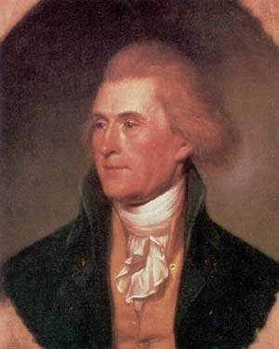
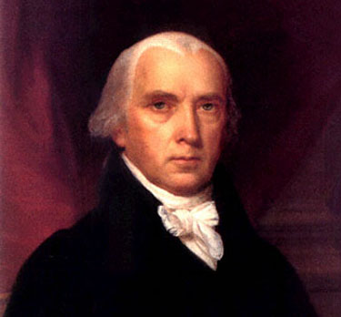
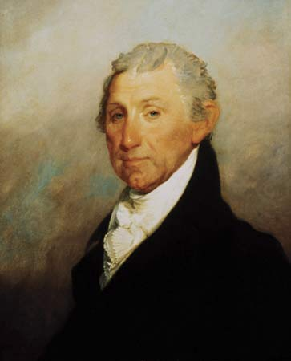
Chapter 11 The Triumphs and Travails of the Jeffersonian Republic
Telling the Story

Slide 2
Tell the Story of…
The 1st 2-party system
Federalists vs. Democratic-Republicans
Thomas Jefferson
Monticello
Election of 1800
“whispering campaigns”
Sally Hemings
Aaron Burr
Albert Gallatin
James Madison
12th Amendment

Slide 3
Tell the Story of…
1st inaugural address
“We are all Republicans…”
pell-mell seating at official dinners
messages sent to Congress
“few die, none resign”
pardoning of “martyrs”
naturalization law of 1802
end of the excise tax
funding of debt, bank, protective tariff

Slide 4
Tell the Story of…
Judiciary Act of 1801
“midnight judges”
Marbury v. Madison
John Marshall
judicial review
impeachment of Samuel Chase

Slide 5
Tell the Story of…
reduction of military
“peaceful coercion”
Barbary pirates
“from the Halls of Montezuma to the shores of Tripoli”
New Orleans
Napoleon Bonaparte
Toussaint L’Ouverture (Santo Domingo revolt)
Louisiana Purchase (1803)
Lewis & Clark
Zebulon Pike
“empire of liberty”

Slide 6
Tell the Story of…
Aaron Burr
Burr’s secessionist conspiracies
Alexander Hamilton
Burr-Hamilton duel

Slide 7
Tell the Story of…
Orders in Council
impressment
Chesapeake incident (1807)
Embargo Act (1807)
Non-Intercourse Act (1809)
American manufacturing

Slide 8
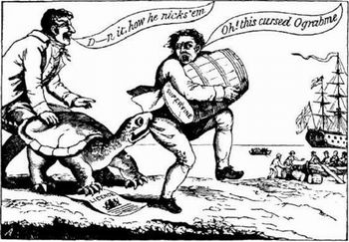
Ograbme

Slide 9
Tell the Story of…
James Madison (1809)
Macon’s Bill No. 2
Napoleon Bonaparte
Orders in Council

Slide 10
Tell the Story of…
12th Congress
“war hawks”
Tecumseh
Battle of Tippecanoe (1811)
William Henry Harrison
War of 1812
“Mr. Madison’s War”

